Slide 1
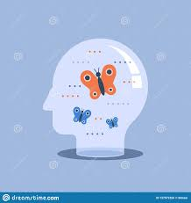
WICCI- Empathy & Emotional Well Being
West Bengal Chapter

Slide 2







How is Mental Health affecting India?
42.5%
To emphasize the scope of the problem, Amber Alam quotes a 2015 research by industry association Assocham, which indicated that 42.5 percent of private-sector employees had symptoms of general anxiety disorder or depression.
Anxiety
Depression
45-50%
Increase
The study, which included 1,250 employees from 150 companies, also discovered that anxiety and depression among corporate employees increased 45-50 percent between 2008 and 2015.
and that nearly 38.5 percent of those polled slept less than six hours per night, which is a major contributor to depression and hypertension..
38.5%
> 6hrs Sleep

Slide 3

Vision
The Empathy and Emotional Well being council – West Bengal chapter in committed to address growing concerning Emotional well being by addressing the lack of knowledge/ understanding about physical and mental wellbeing in the state of West Bengal.

Slide 4

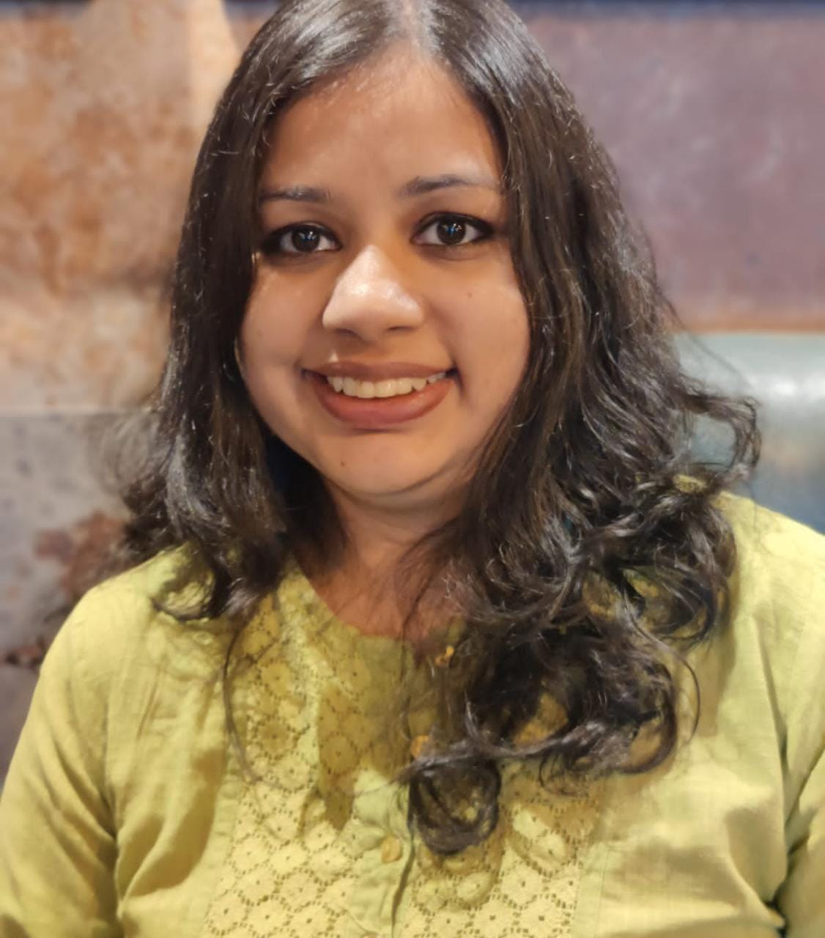
President: Swati Ghoshal
Swati is a counselling psychologist and a mental health advocate. She is the founder of Psychlth, which provides a range of counselling services to clients coming from varied age groups (18+ years) and backgrounds
As a CBT (cognitive behavioural therapy) practitioner, Swati’s approach to mental health includes helping you understand your internal thought processes and overcome your life challenges be it on a personal or on a professional front.
Swati has previously worked as a consultant with the Department of women and child development, Government of Delhi and is currently empaneled with several mental health organizations.

Slide 5
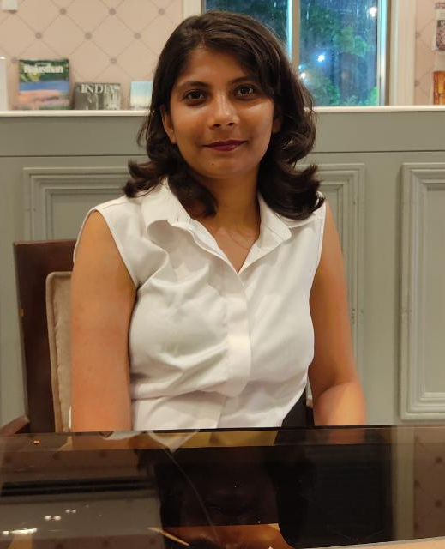
Vice President: Kratika Gupta
Kratika Gupta is a Counselling Psychologist basing out of Kolkata and has a masters in Applied Psychology.
She caters to the young adults and helps them deal with their various mental health concerns. Her knowledge in several modalities of therapy makes her a versatile therapy professional with an eclectic approach.
As a professional she believes that counselling sessions must be tailored according to the unique needs of the client as an individual. Afterall, “not one size fits all”

Slide 6
Khushbu Baid
Khusbu Baid is a counselling psychologist with a passion in studying human behaviour. After completing her masters from Indian institute of Psychology and Research (IIPR, Bangalore), she joined Cult Fit and currently working as a lifestyle coach.
She has also published in Indian Journal of Health and Well Being (IJHW) and has taken up personal projects on Impact of mindfulness-based intervention among doctors on COVID 19 duty (2021), Relationship between job satisfaction & marital adjustment for public and private sector employees (2018) and Effect of social interaction on depression in older adults in the Indian context (2017).

Slide 7
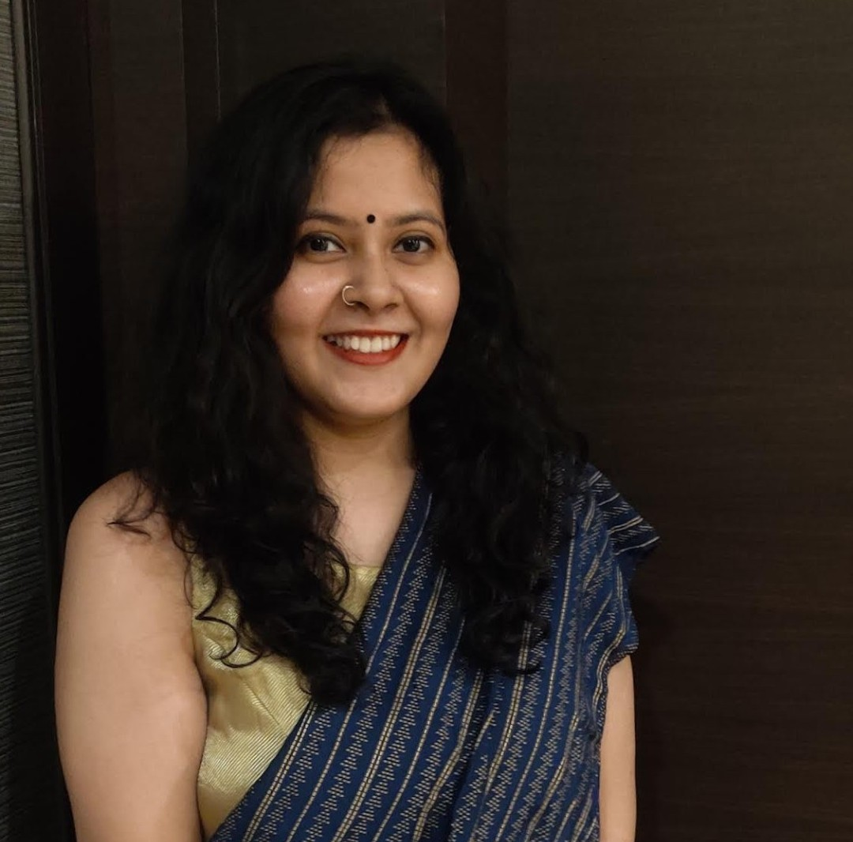
Shruti Bose
Shruti Bose is alumni of Christ (Deemed to be University) and has private practice in Kolkata. She is a counselling psychologist and a play therapy practitioner, who is currently practicing independently in Kolkata and is also associated with EMOTICONS India and Whaterr Solutions.
She has also been a recipient of President Shield Award (Rashtrapati Puraskar) in the year 2016.
She works majorly with adolescents and adults to help them with their day-to-day concerns with a major focus on a strength-based approach and helping individuals shape a positive narrative for themselves and their world.

Slide 8
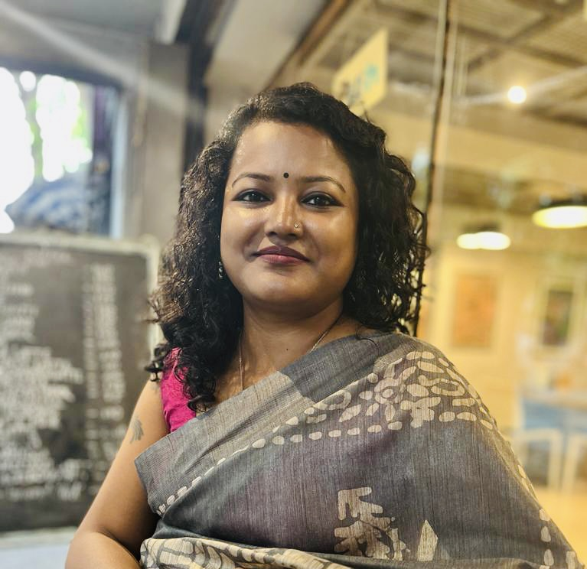
Bidisha Barman
Bidisha is a Mental health & psychosocial counselor, with more than 10 years of experience, focuses on empowering individuals with capacity building, psychoeducation, individual counseling, support groups, and case management services to enhance her client’s quality of life. She has a Masters in Clinical Psychology and has worked in schools, and hospitals and presently working in the development sector.
Psychosocial issues are endless, and Bidisha prefers to work on a well-being approach. She believe 'prevention is better than cure' and if as a community, we knew the basics of psychosocial interventions, many issues might be nipped in the bud.

Slide 9
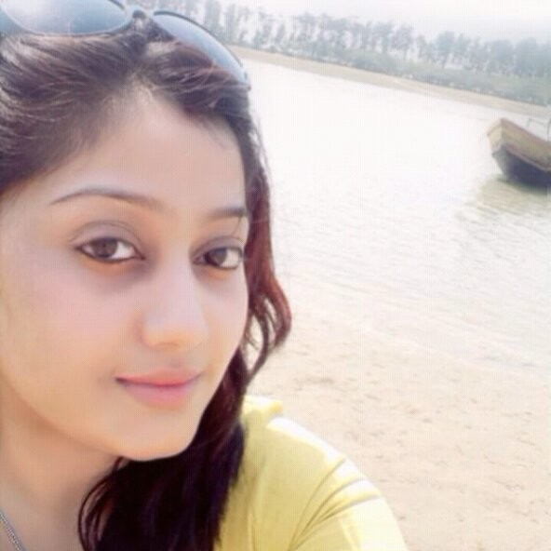
Tina Mukherjee
Tina Mukherjee is an analyst basing out of Kolkata and has a Master in Economics. While working as a research fellow in a govt project she got the opportunity to gather her knowledge about SHG groups in West Bengal.
She utilized this knowledge when she co authored a paper which got publication with Globus Press and the topic covers Empowerment of women.
Tina believes that it is our responsibility to take care of ourselves and support the ignorant and weaker class of women to deal with their issues smartly.

Slide 10
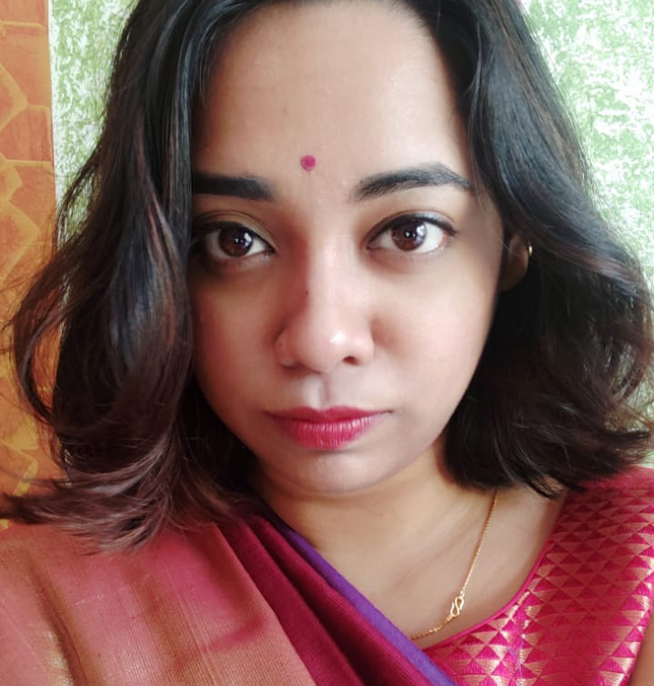
Suvankhi Tarafdar
Suvankhi Tarafdar is a lawyer by profession based out of Kolkata and has a master's degree in corporate law. She is adept at developing content strategies that immediately appeal to the target audiences.
Her background in research and writing has provided her with up-to-date knowledge of marketing and social media, which not only caters to young adults but also reaches a sizable audience.
While her degree in law offers her a viewpoint that is useful in counselling clients on their legal rights and obligations and recommending business and personal courses of action, her experience in several different industries makes her a versatile professional with a progressive approach.

Slide 11
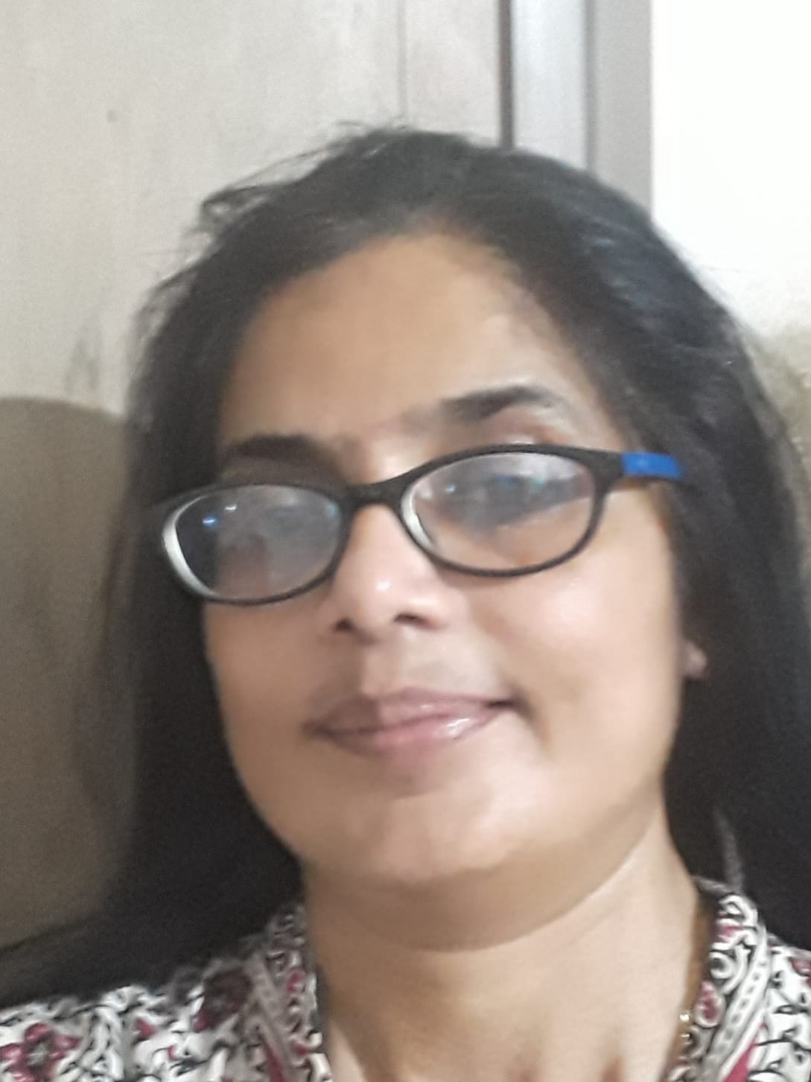
Suvankhi Tarafdar
Rakhi is a passionate development professional with rich expertise in humanitarian development with solid programming experience in Organisational Behaviour, Gender, Women Empowerment, Agriculture, Livelihoods, Disaster Management and Community Resilience.
She has worked with international non-profits and a premier management institute responsible for leading country and programme operations, executing in-country partnerships/collaborations, leading change management, managing partner and donor relations, mentoring teams, leading research and external communications, training partners (NGOs)
She is currently working with an Irish charity on protecting the rights of street-connected children as a Consultant-Grants Development to support fundraising from international donors.

Slide 12
LIST of Names & Emails of all council members
Position | Name | Email id
President | Swati Ghoshal | Swati.ghoshal@psychlth.com
Vice President | Kratika Gupta | kratika1710@gmail.com
Council Member | Khushbu Baid | khusbubaid.auxi@gmail.com
Council Member | Shruti Bose | shrutibose15@gmail.com
Council Member | Bidisha Barman | bidisha.hiver@gmail.com
Council Member | Tina Mukherjee | tinamukherjee5_44m@indeedemail.com
Council Member | Suvankhi Tarafdar | suvankhi97@gmail.com
Council Member | Rakhi Bhattacharya | rakhi.bhattacharya@gmail.com

